Slide 1
Learning
Chapter 18 and Parts of Chapter 20
AI systems are complex and may have many parameters.
It is impractical and often impossible to encode all the knowledge a system needs.
Different types of data may require very different parameters.
Instead of trying to hard code all the knowledge, it makes sense to learn it.

Slide 2
Learning from Observations
Supervised Learning – learn a function from a set of training examples which are preclassified feature vectors.
feature vector class
(square, red) I
(square, blue) I
(circle, red) II
(circle blue) II
(triangle, red) I
(triange, green) I
(ellipse, blue) II
(ellipse, red) II
Given a previously unseen
feature vector, what is the
rule that tells us if it is in
class I or class II?
(circle, green) ?
(triangle, blue) ?

Slide 3
Learning from Observations
Unsupervised Learning – No classes are given. The idea is to find patterns in the data. This generally involves clustering.
Reinforcement Learning – learn from feedback after a decision is made.

Slide 4
Topics to Cover
Inductive Learning
  decision trees
  ensembles
  Bayesian decision making
  neural nets

Slide 5
Decision Trees
Theory is well-understood.
Often used in pattern recognition problems.
Has the nice property that you can easily understand the decision rule it has learned.

Slide 6
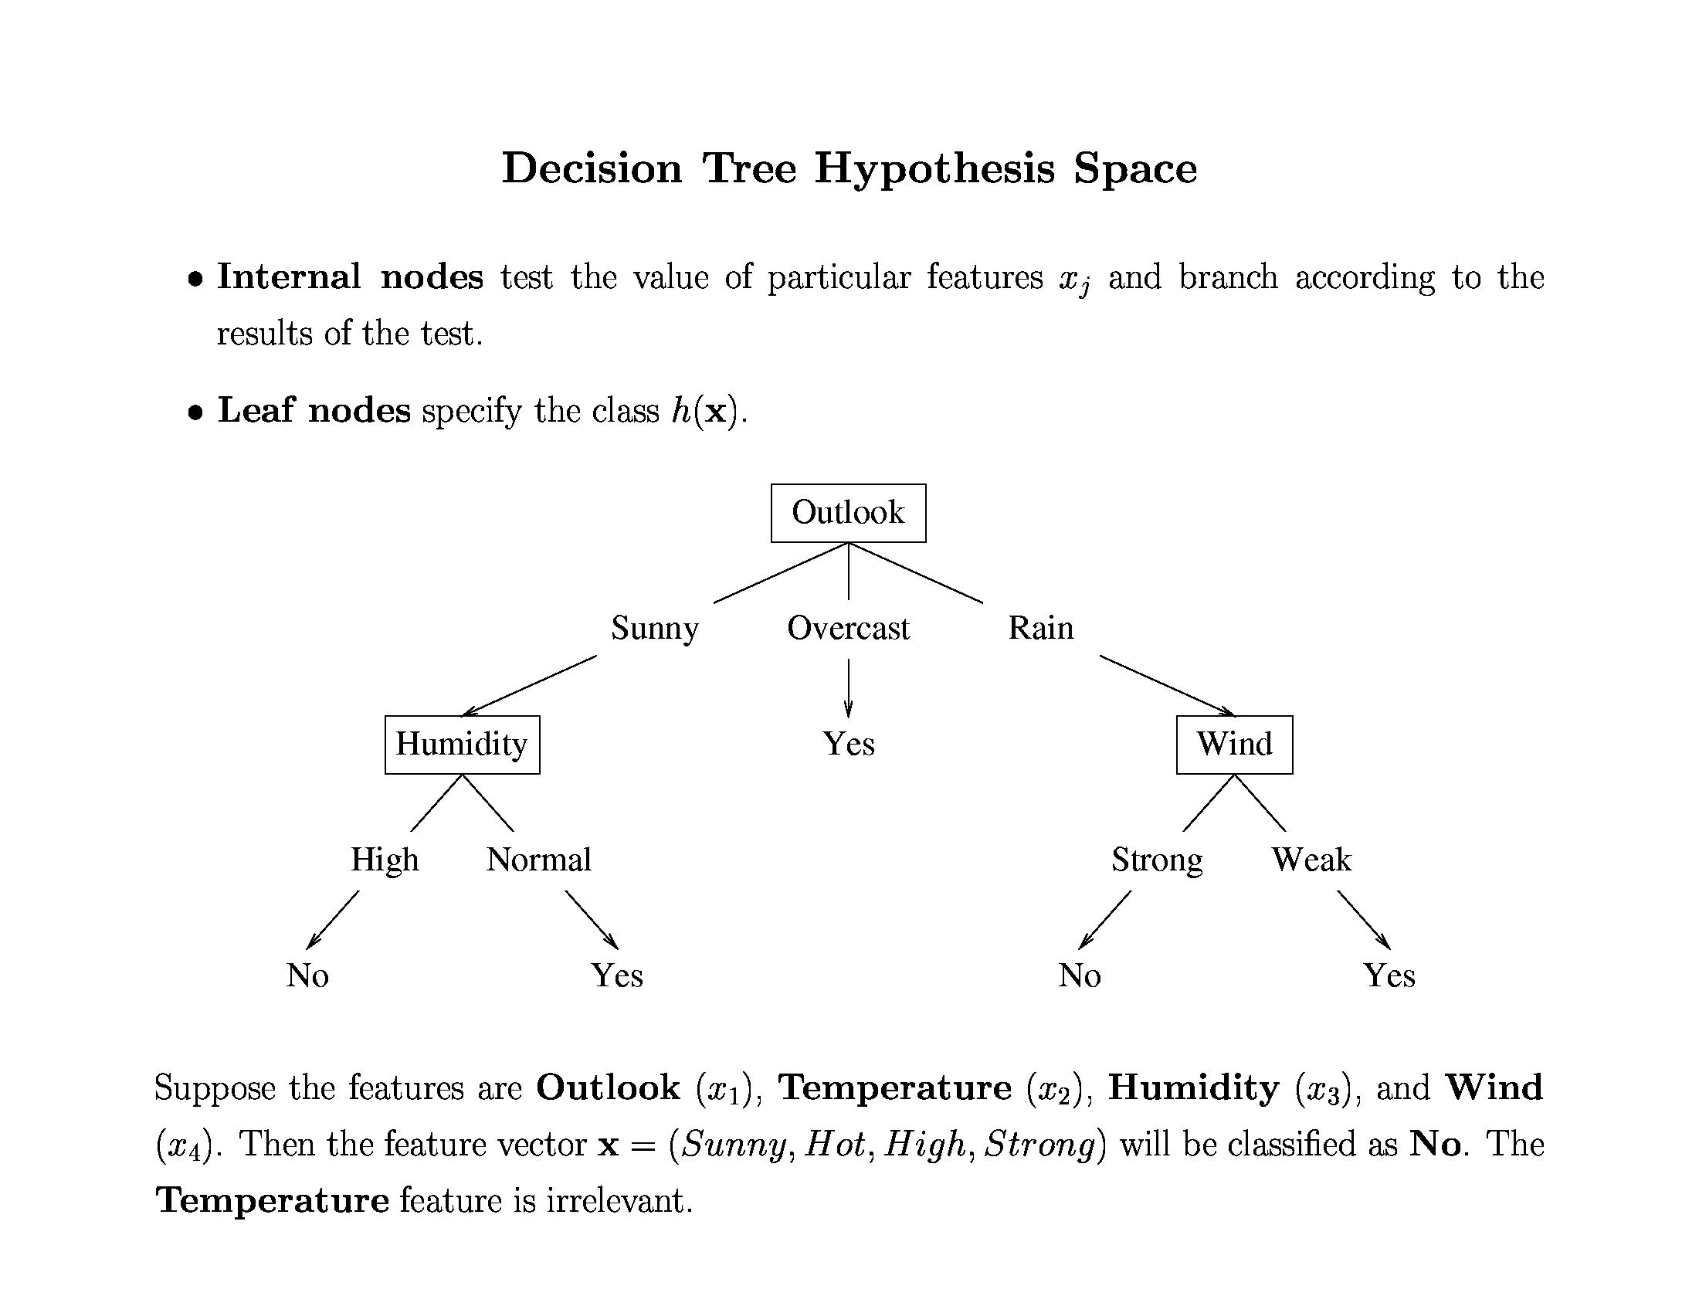
Shall I play tennis today?

Slide 7
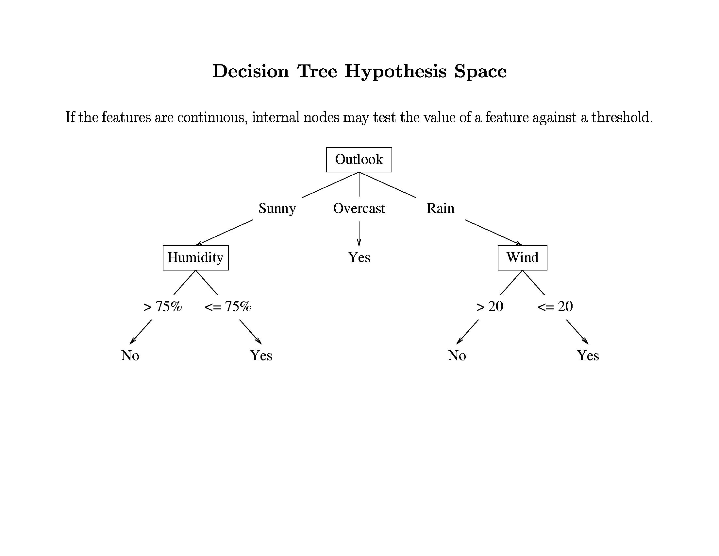

Slide 8
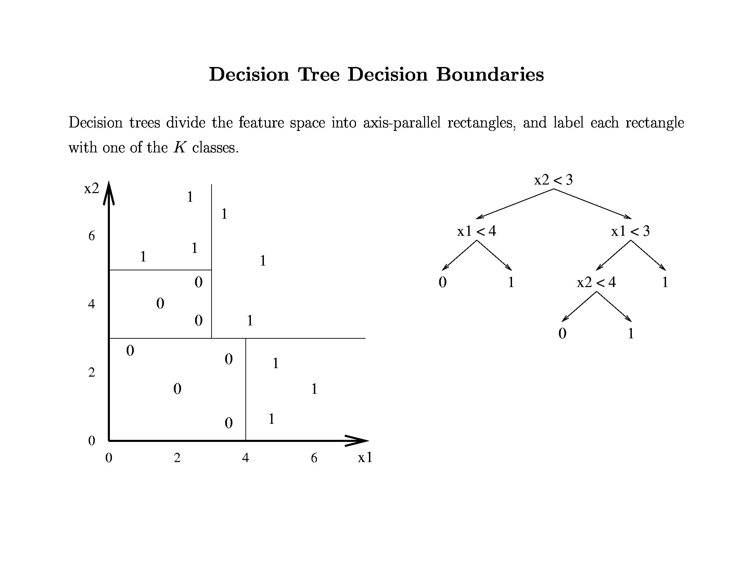

Slide 9
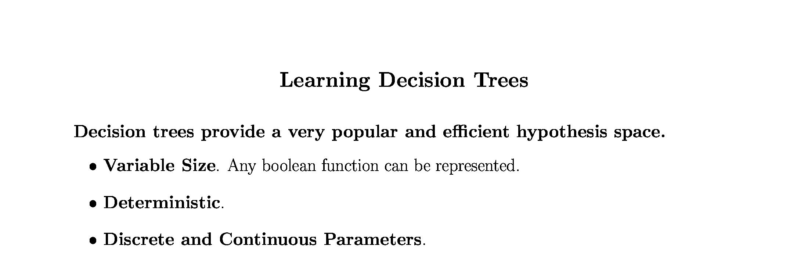

Slide 10
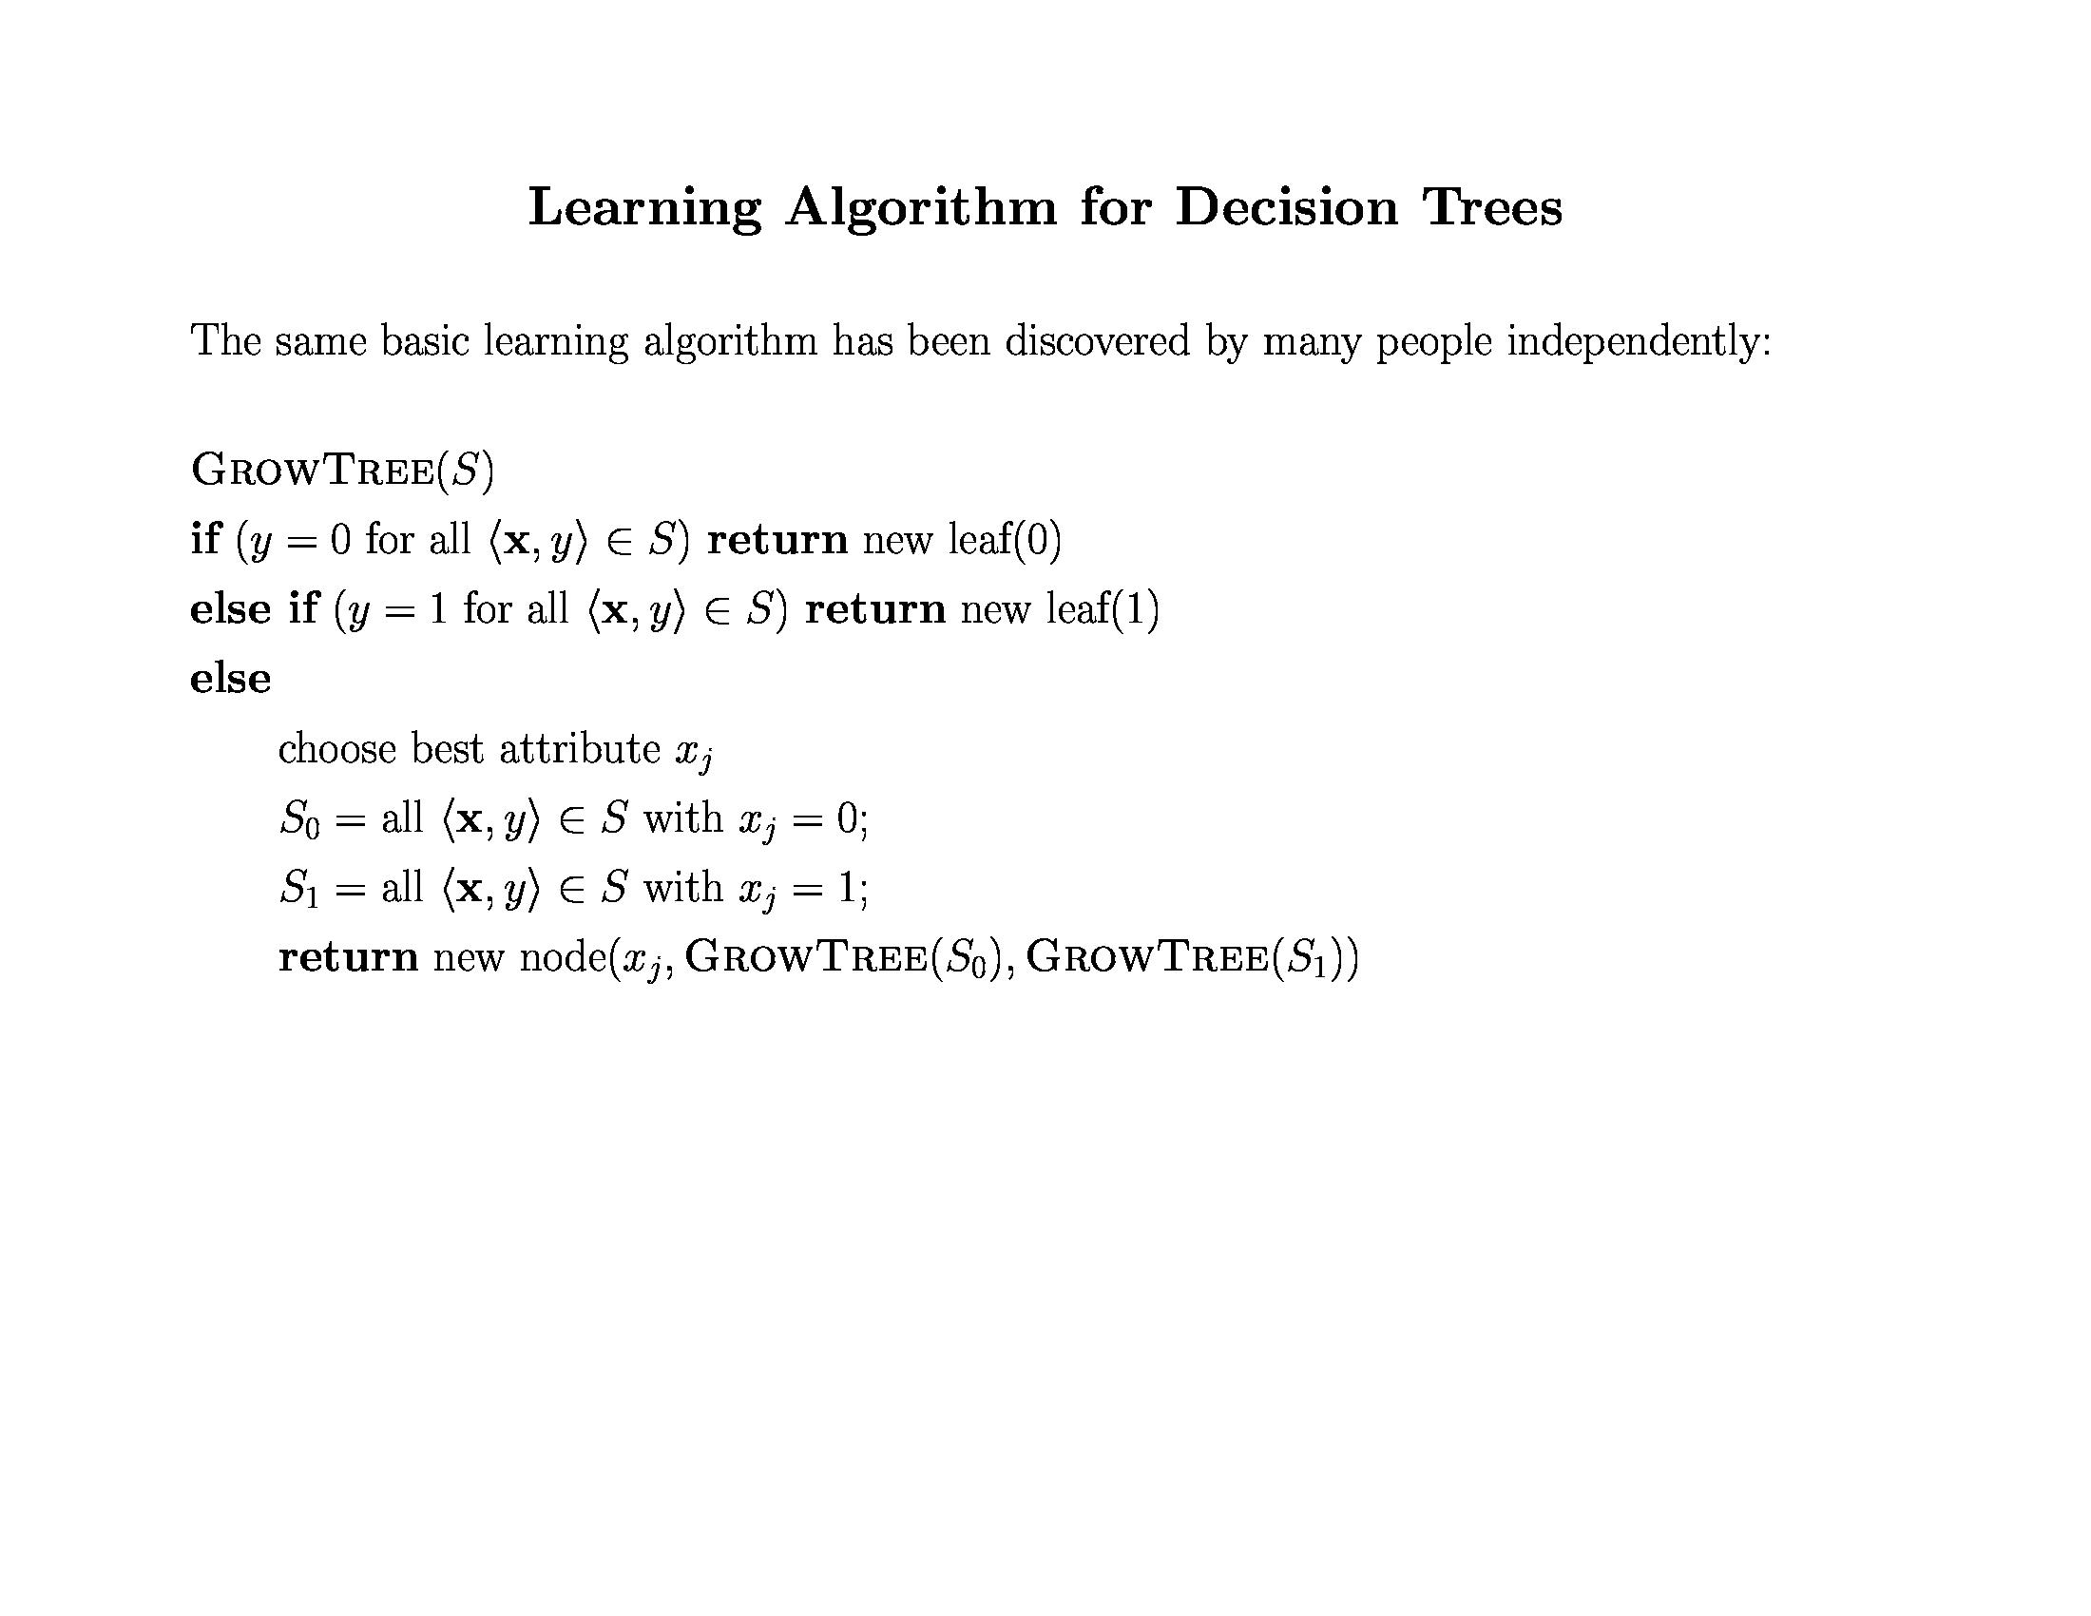
How do we choose the best attribute?
What should that attribute do for us?

Slide 11
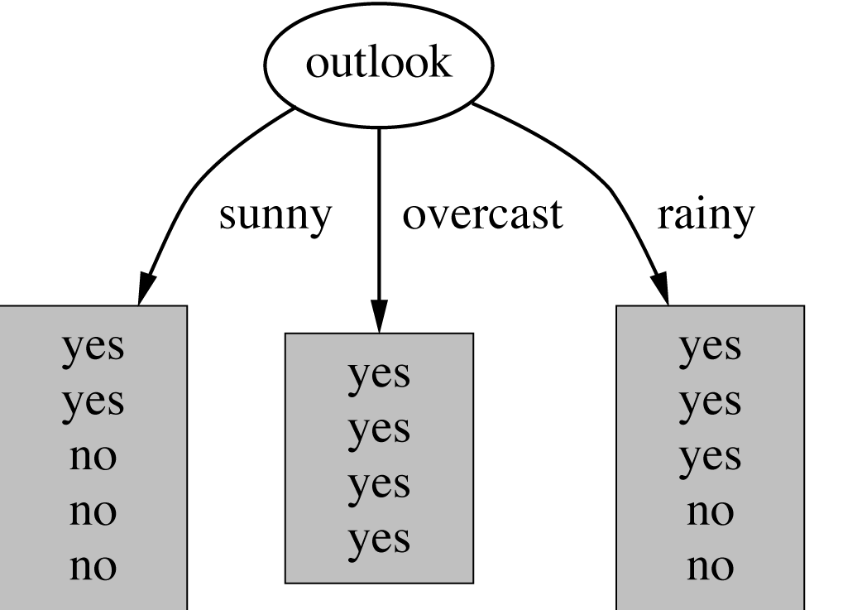
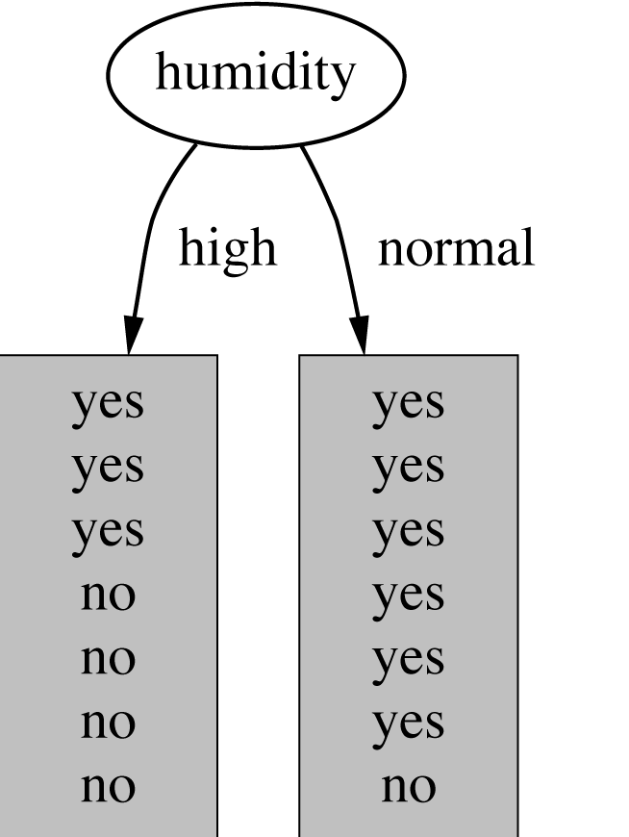
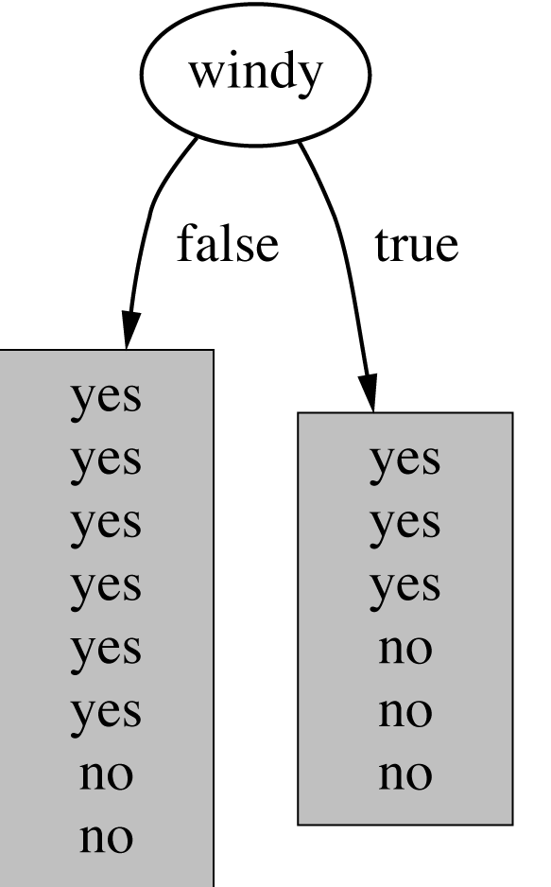
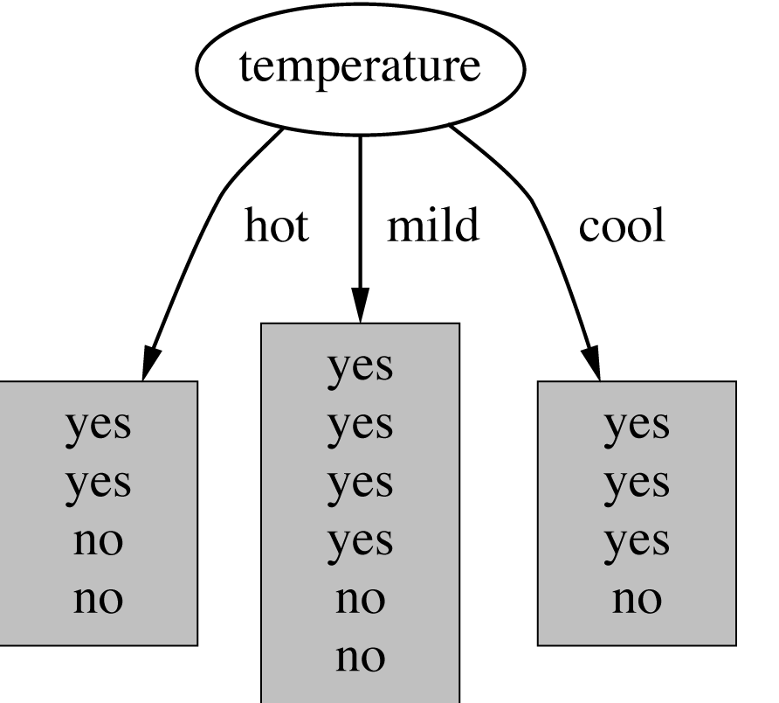
Which attribute to select?
witten&eibe

Slide 12
Criterion for attribute selection
Which is the best attribute?
  The one which will result in the smallest tree
  Heuristic: choose the attribute that produces the “purest” nodes
Need a good measure of purity!
  Maximal when?
  Minimal when?

Slide 13
Information Gain
Which test is more informative?
Split over whether Balance exceeds 50K
Split over whether applicant is employed
Less or equal 50K
Over 50K
Unemployed
Employed

Slide 14
Information Gain
Impurity/Entropy (informal)
  Measures the level of impurity in a group of examples

Slide 15
Impurity
Very impure group
Less impure
Minimum
impurity

Slide 16
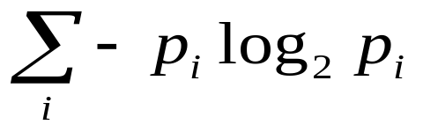
Entropy: a common way to measure impurity
Entropy =
  p_{i} is the probability of class i
  Compute it as the proportion of class i in the set.
Entropy comes from information theory. The higher the entropy the more the information content.
What does that mean for learning from examples?

Slide 17
2-Class Cases:
Minimum
impurity
What is the entropy of a group in which all examples belong to the same class?
  entropy = - 1 log₂1 = 0
What is the entropy of a group with 50% in either class?
  entropy = -0.5 log₂0.5 – 0.5 log₂0.5 =1
not a good training set for learning
Maximum
impurity
good training set for learning

Slide 18
Information Gain
We want to determine which attribute in a given set of training feature vectors is most useful for discriminating between the classes to be learned.
Information gain tells us how important a given attribute of the feature vectors is.
We will use it to decide the ordering of attributes in the nodes of a decision tree.

Slide 19
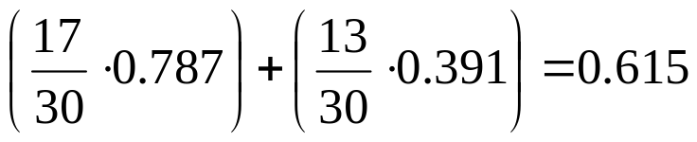
Calculating Information Gain
Information Gain = entropy(parent) – [average entropy(children)]
child
entropy
Entire population (30 instances)
17 instances
child
entropy
parent
entropy
13 instances
(Weighted) Average Entropy of Children =
Information Gain= 0.996 - 0.615 = 0.38

Slide 20
Entropy-Based Automatic Decision Tree Construction
Training Set S
x1=(f11,f12,…f1m)
x2=(f21,f22, f2m)
.
.
xn=(fn1,f22, f2m)
Node 1
What feature
should be used?
What values?
Quinlan suggested information gain in his ID3 system
and later the gain ratio, both based on entropy.

Slide 21
Using Information Gain to Construct a Decision Tree
Choose the attribute A
with highest information
gain for the full training
set at the root of the tree.
Full Training Set S
Attribute A
v1
v2
vk
Construct child nodes
for each value of A.
Each has an associated
subset of vectors in
which A has a particular
value.
Set S ′
S′={s∈S | value(A)=v1}
repeat
recursively
till when?
Information gain has the disadvantage that it prefers
attributes with large number of values that split the
data into small, pure subsets. Quinlan’s gain ratio
did some normalization to improve this.

Slide 22
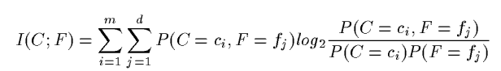
Information Content
The information content I(C;F) of the class variable C
with possible values {c1, c2, … cm} with respect to
the feature variable F with possible values {f1, f2, … , fd}
is defined by:
P(C = c_{i}) is the probability of class C having value c_{i}.
P(F=f_{j}) is the probability of feature F having value f_{j}.
P(C=c_{i},F=f_{j}) is the joint probability of class C = c_{i}
and variable F = f_{j}.
These are estimated from frequencies in the training data.

Slide 23
Simple Example
X Y Z C
1 1 I
1 1 0 I
0 0 1 II
1 0 0 II
How would you distinguish class I from class II?

Slide 24
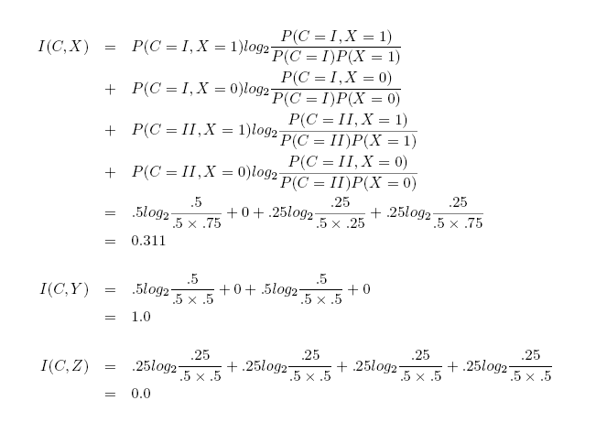
Example (cont)
X Y Z C
1 1 1 I
1 1 0 I
0 0 1 II
1 0 0 II
Which attribute is best? Which is worst? Does it make sense?

Slide 25
Using Information Content
Start with the root of the decision tree and the whole
training set.
Compute I(C,F) for each feature F.
Choose the feature F with highest information
content for the root node.
Create branches for each value f of F.
On each branch, create a new node with reduced
training set and repeat recursively.

Slide 26
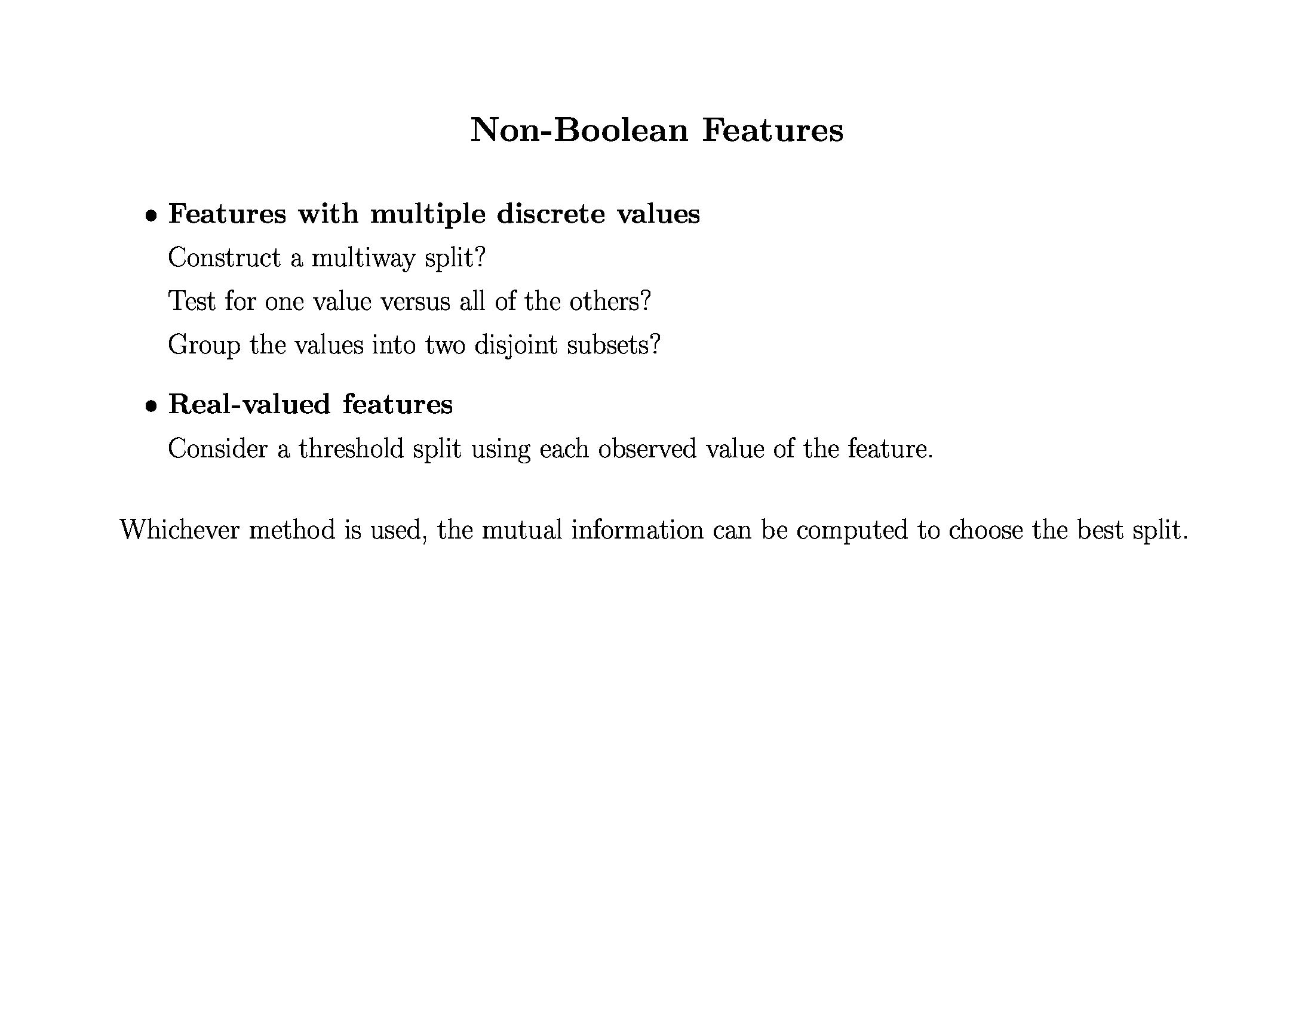

Slide 27
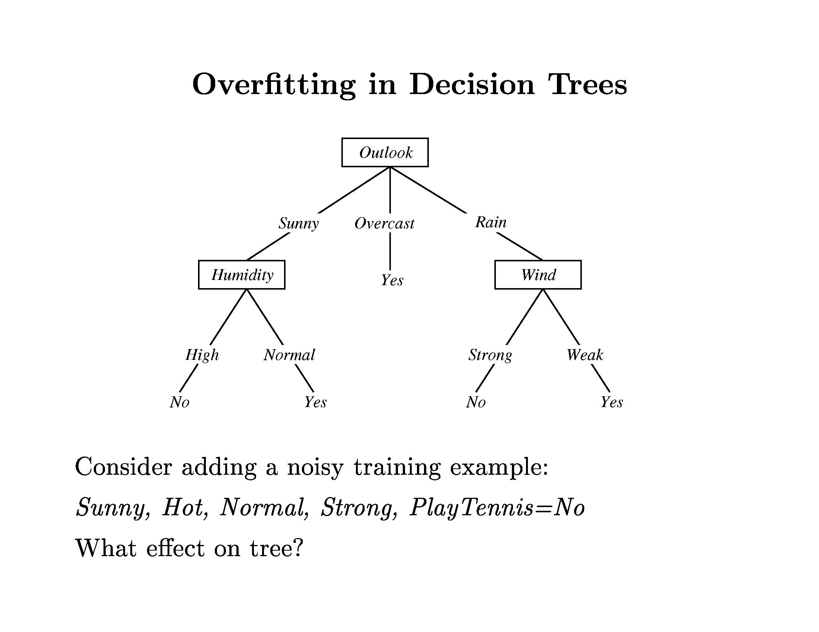

Slide 28
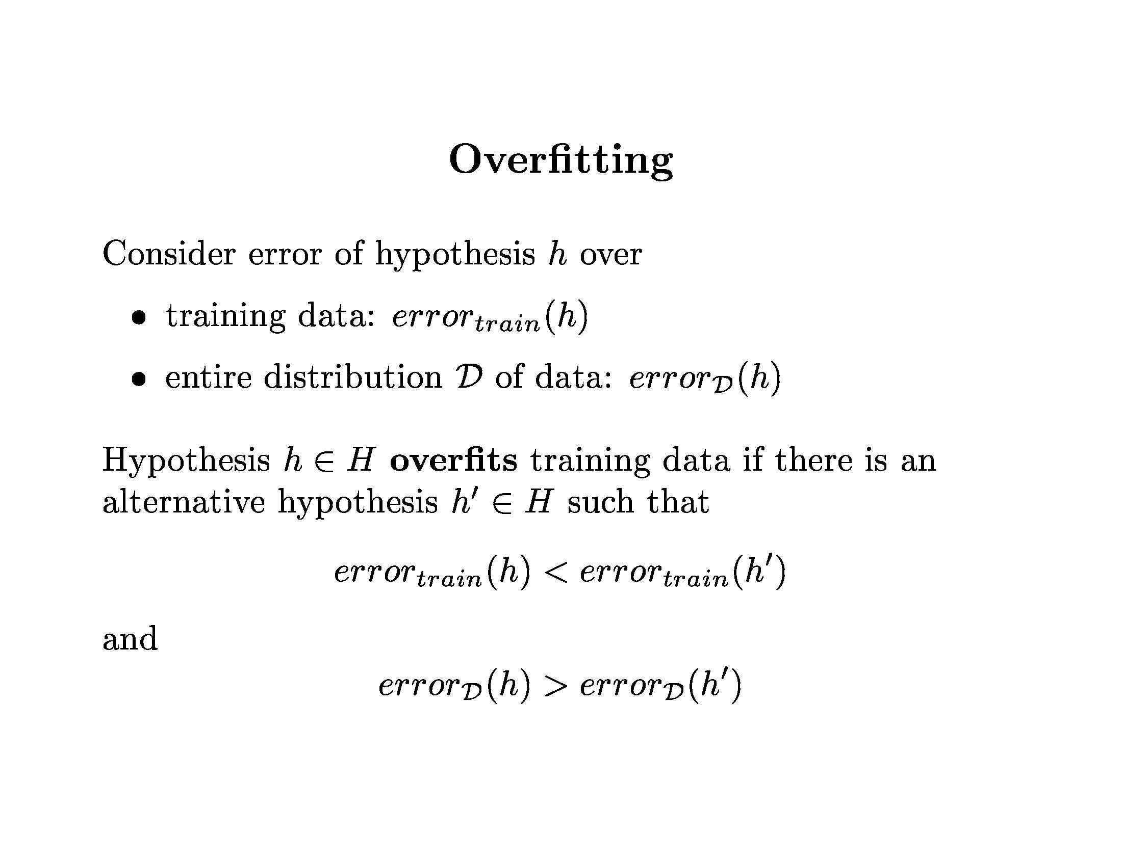

Slide 29
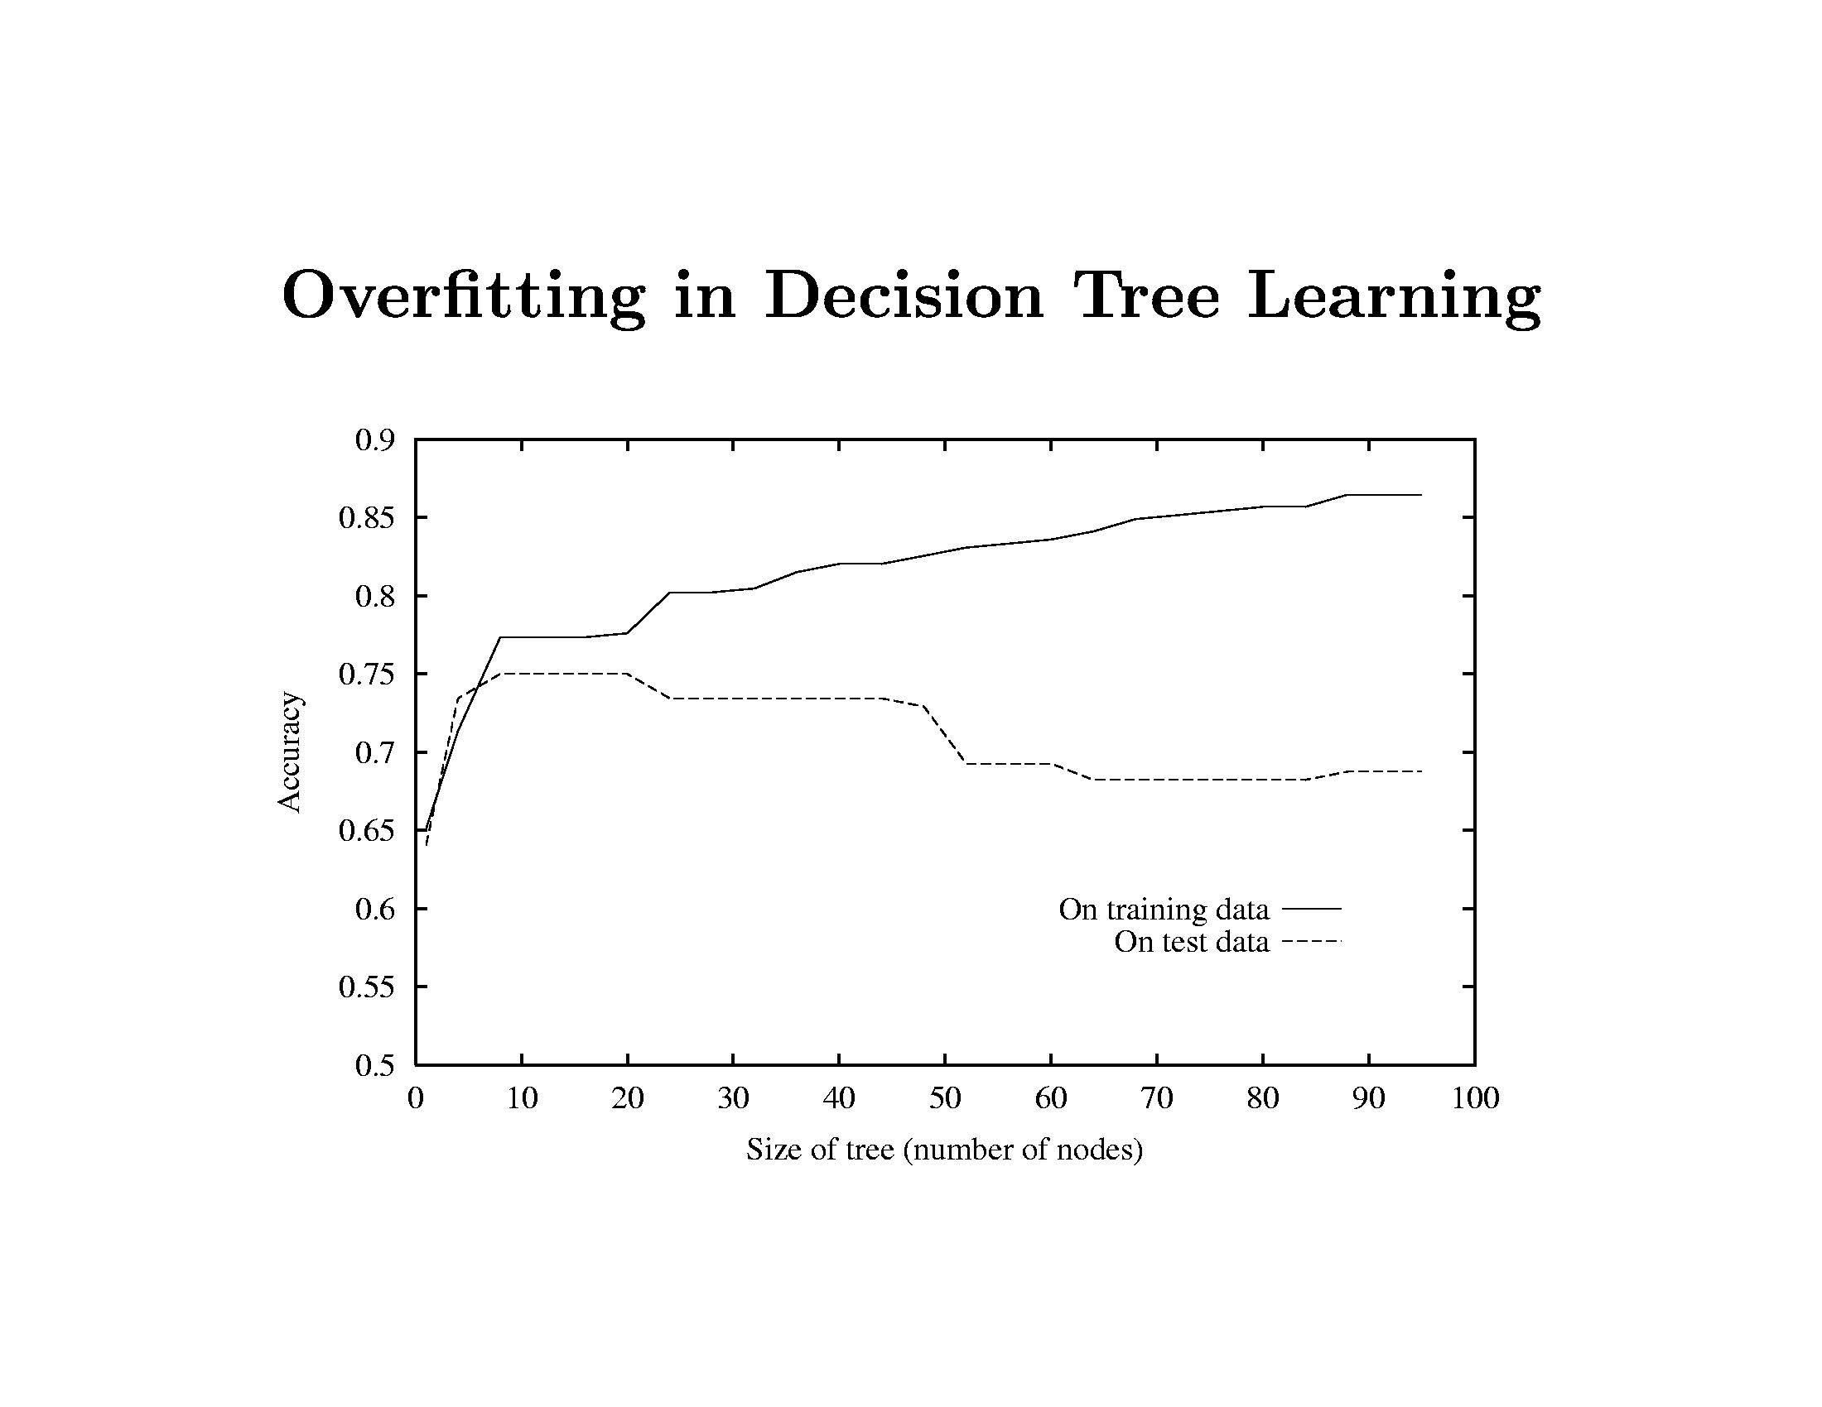

Slide 30
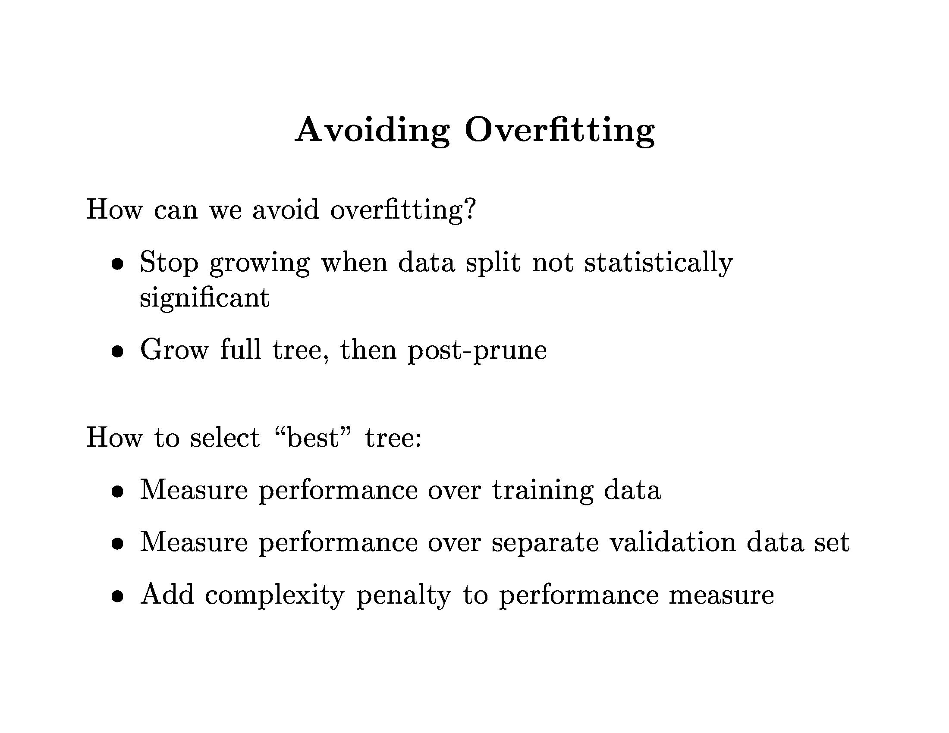

Slide 31
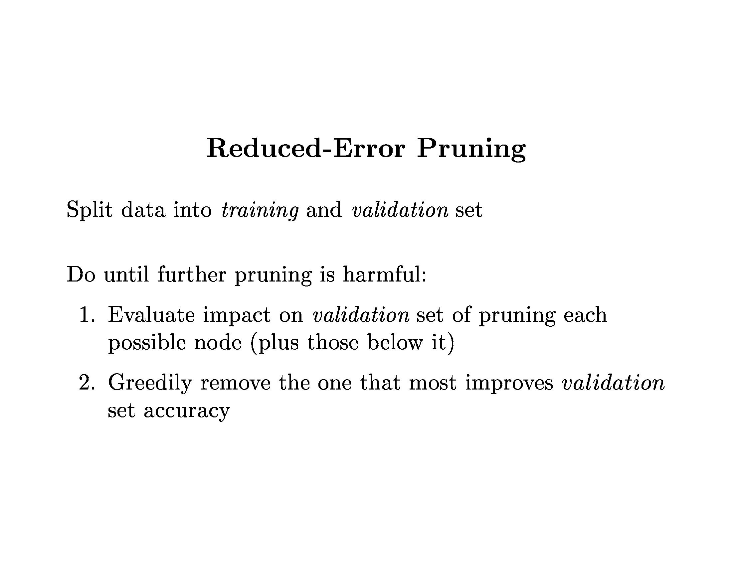

Slide 32
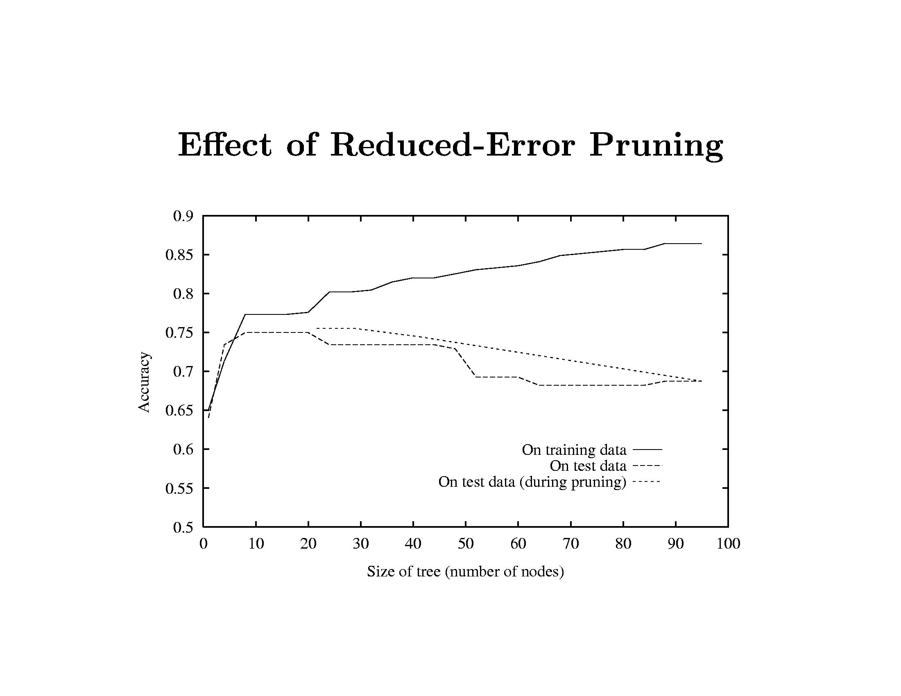
On training data it looks great.
But that’s not the case for the test data.
The tree is pruned back to the red line where
it gives more accurate results on the test data.

Slide 33
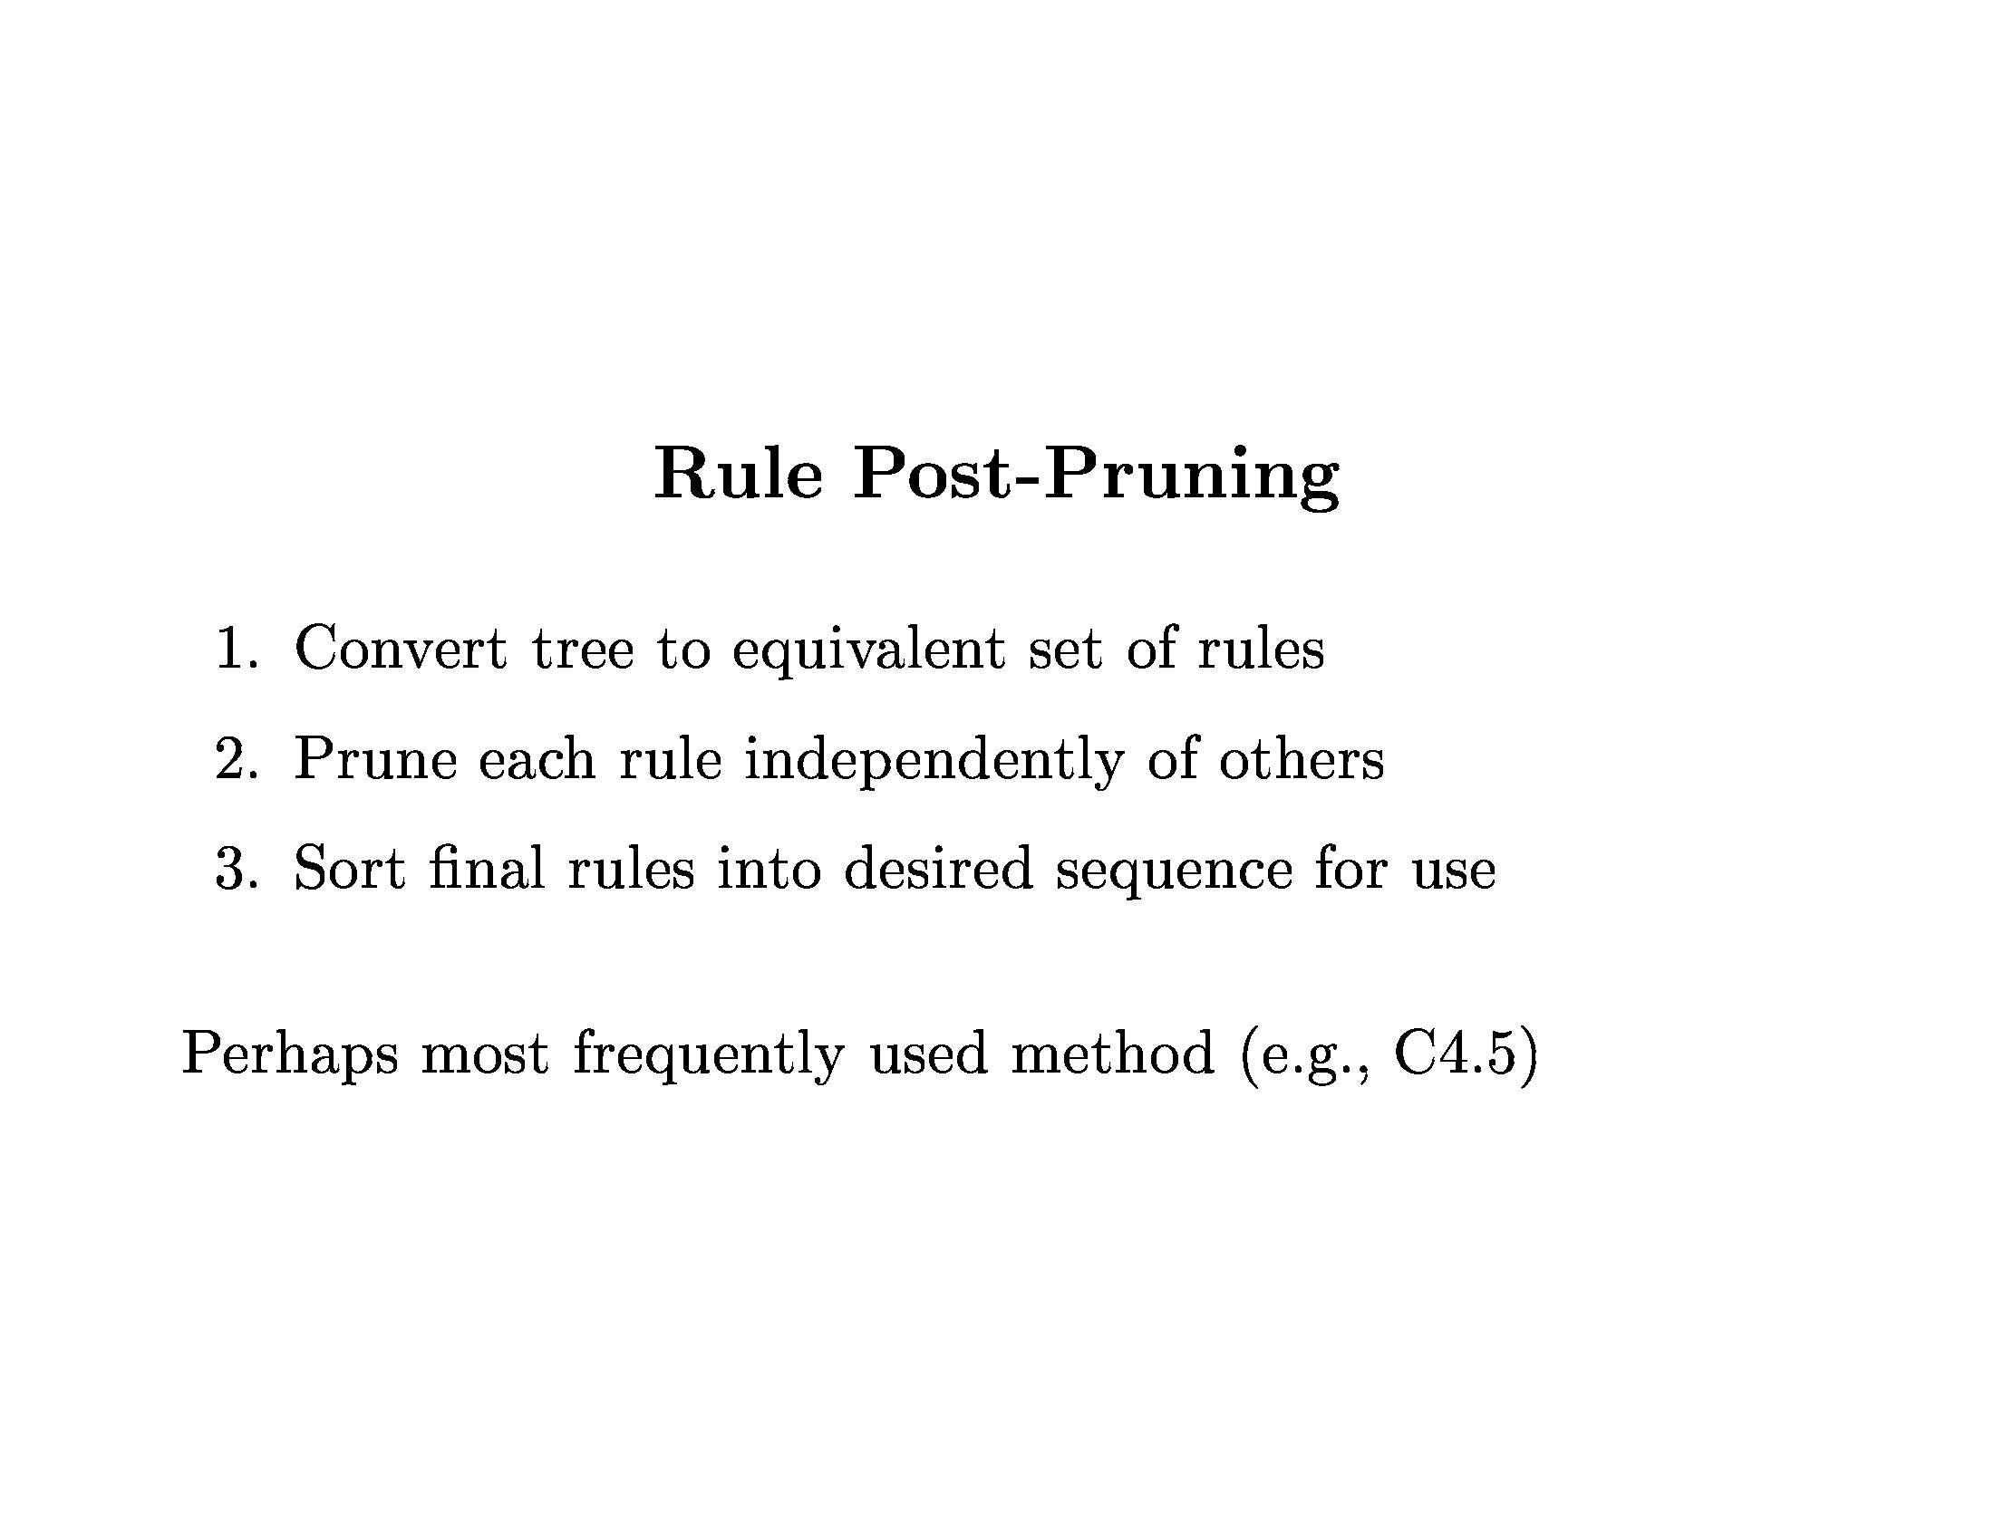

Slide 34
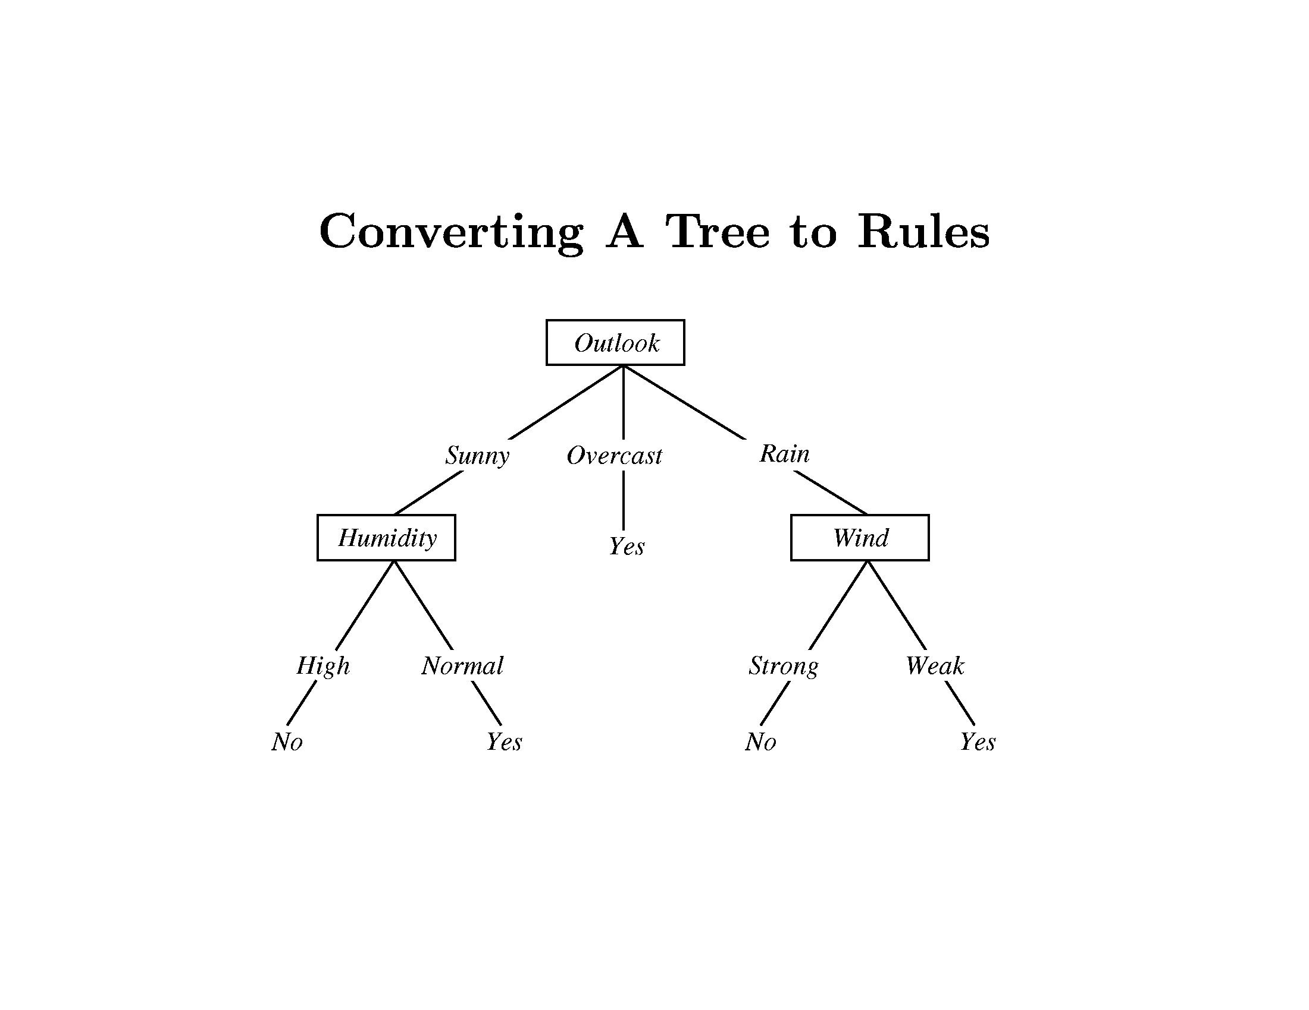

Slide 35
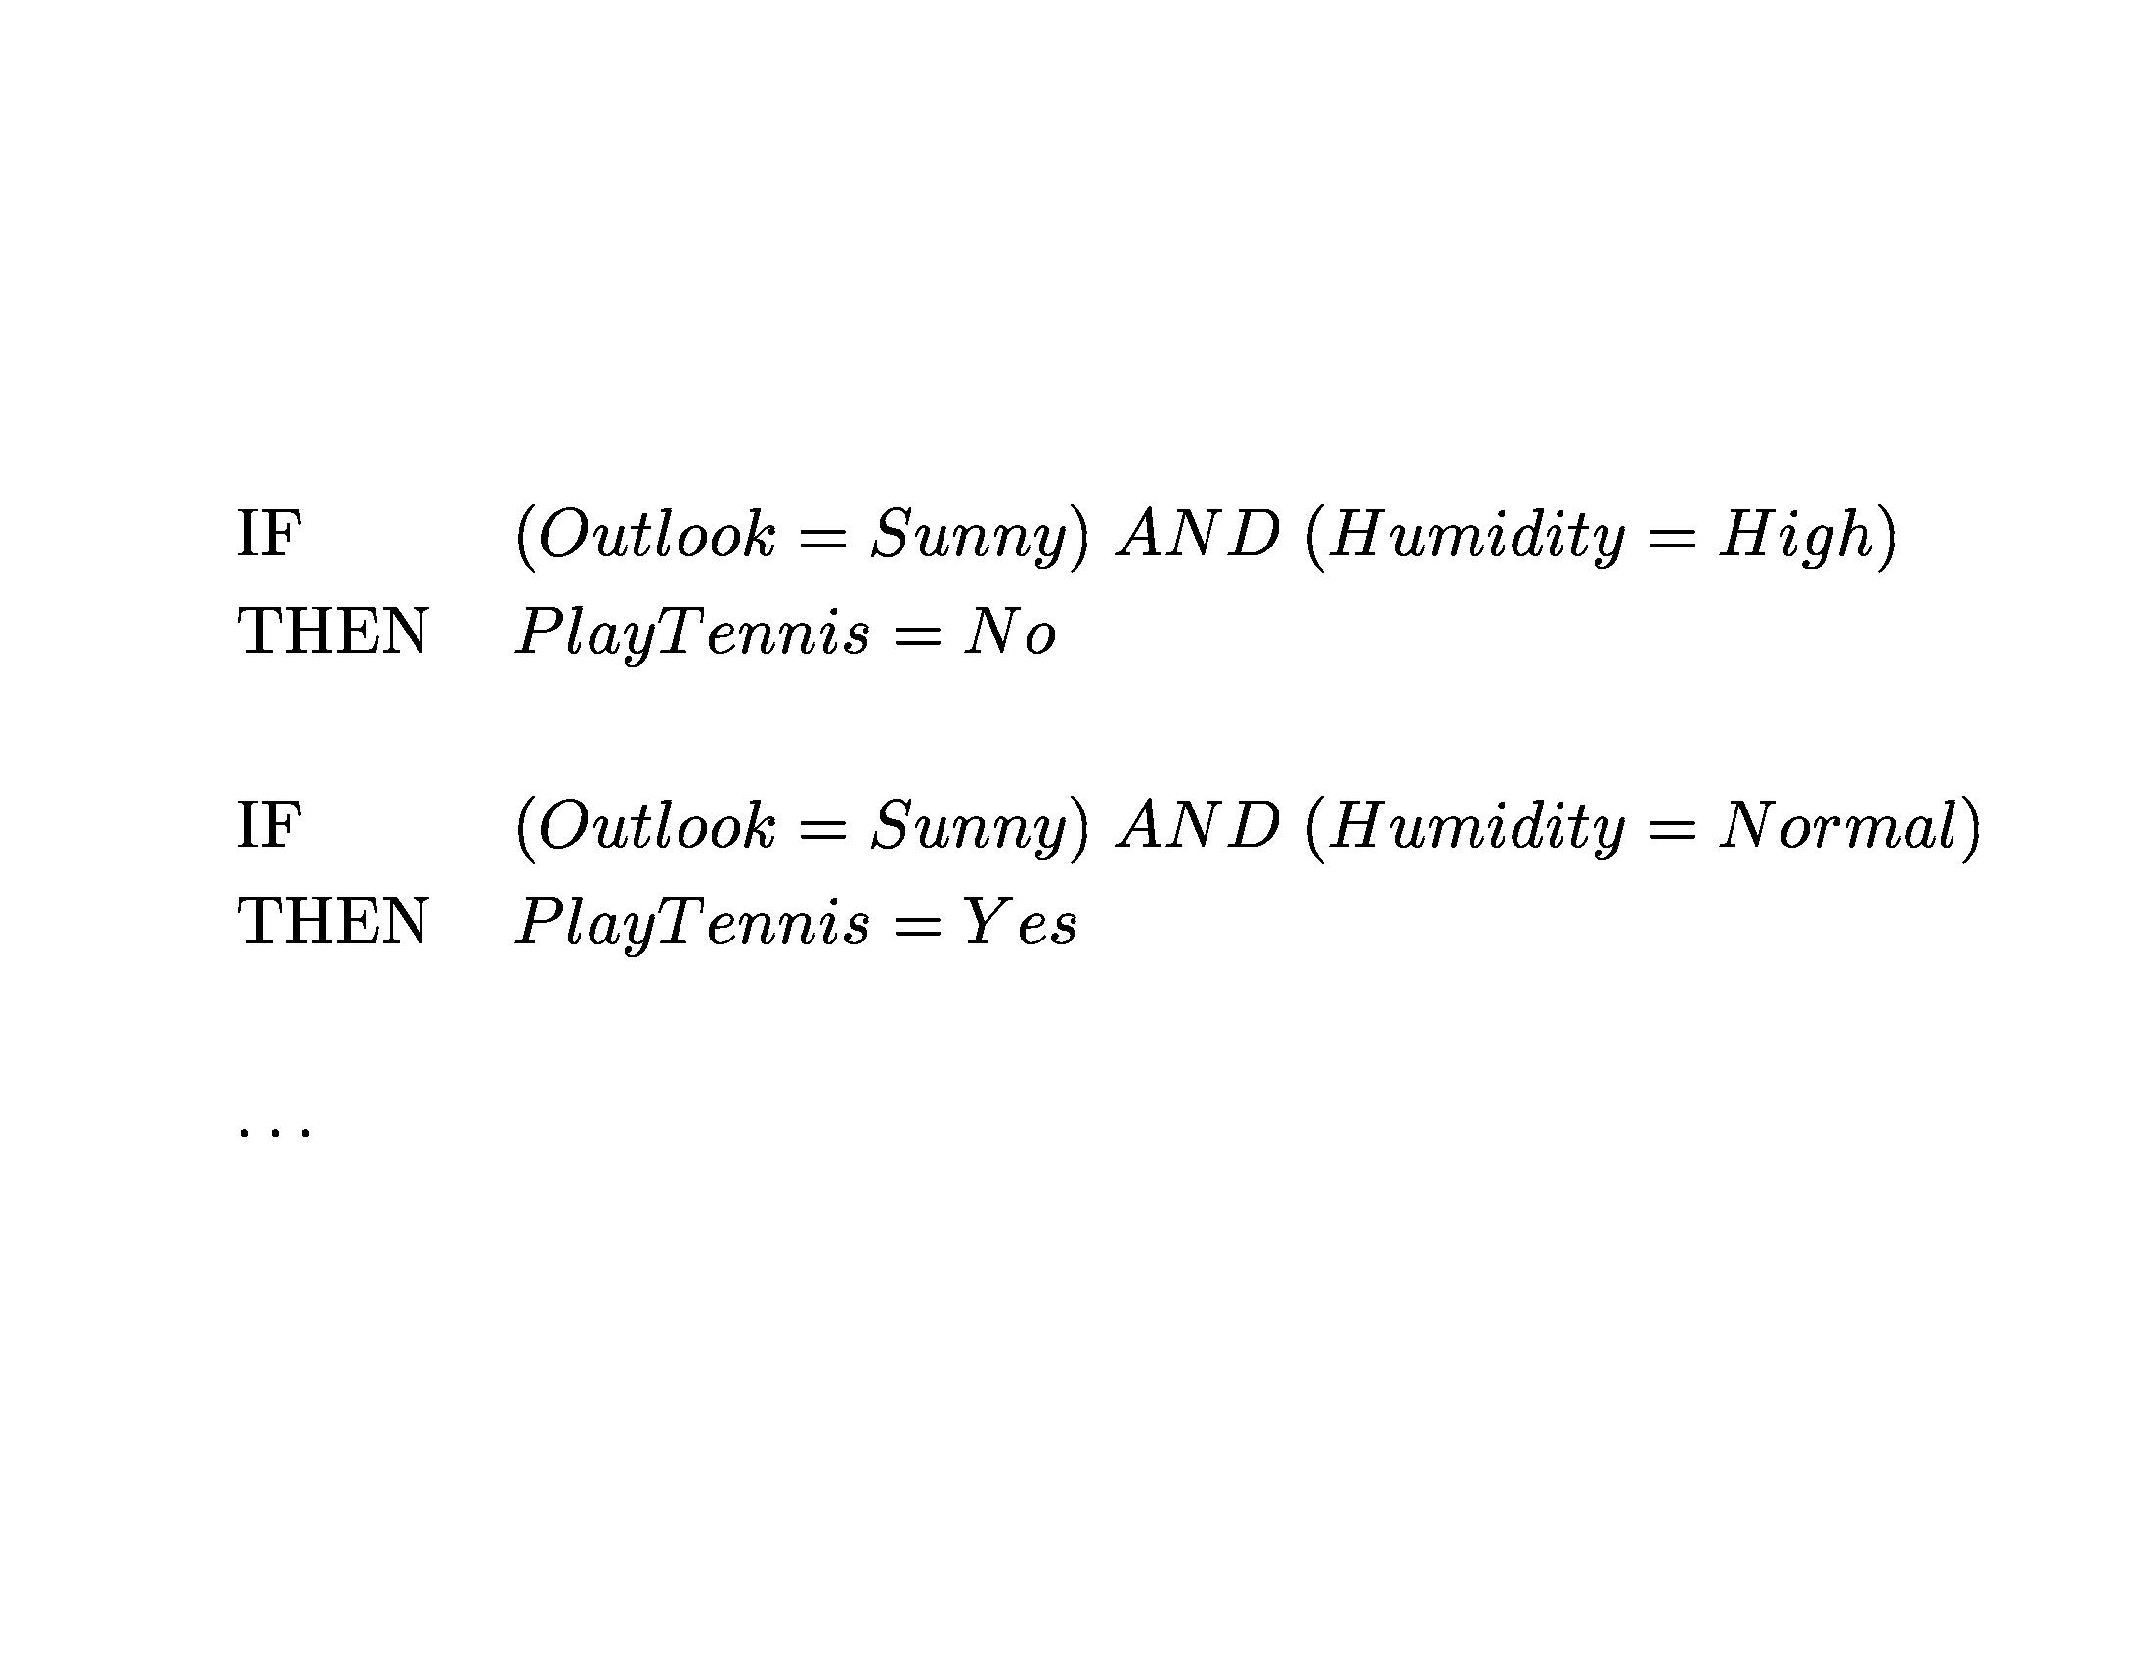

Slide 36
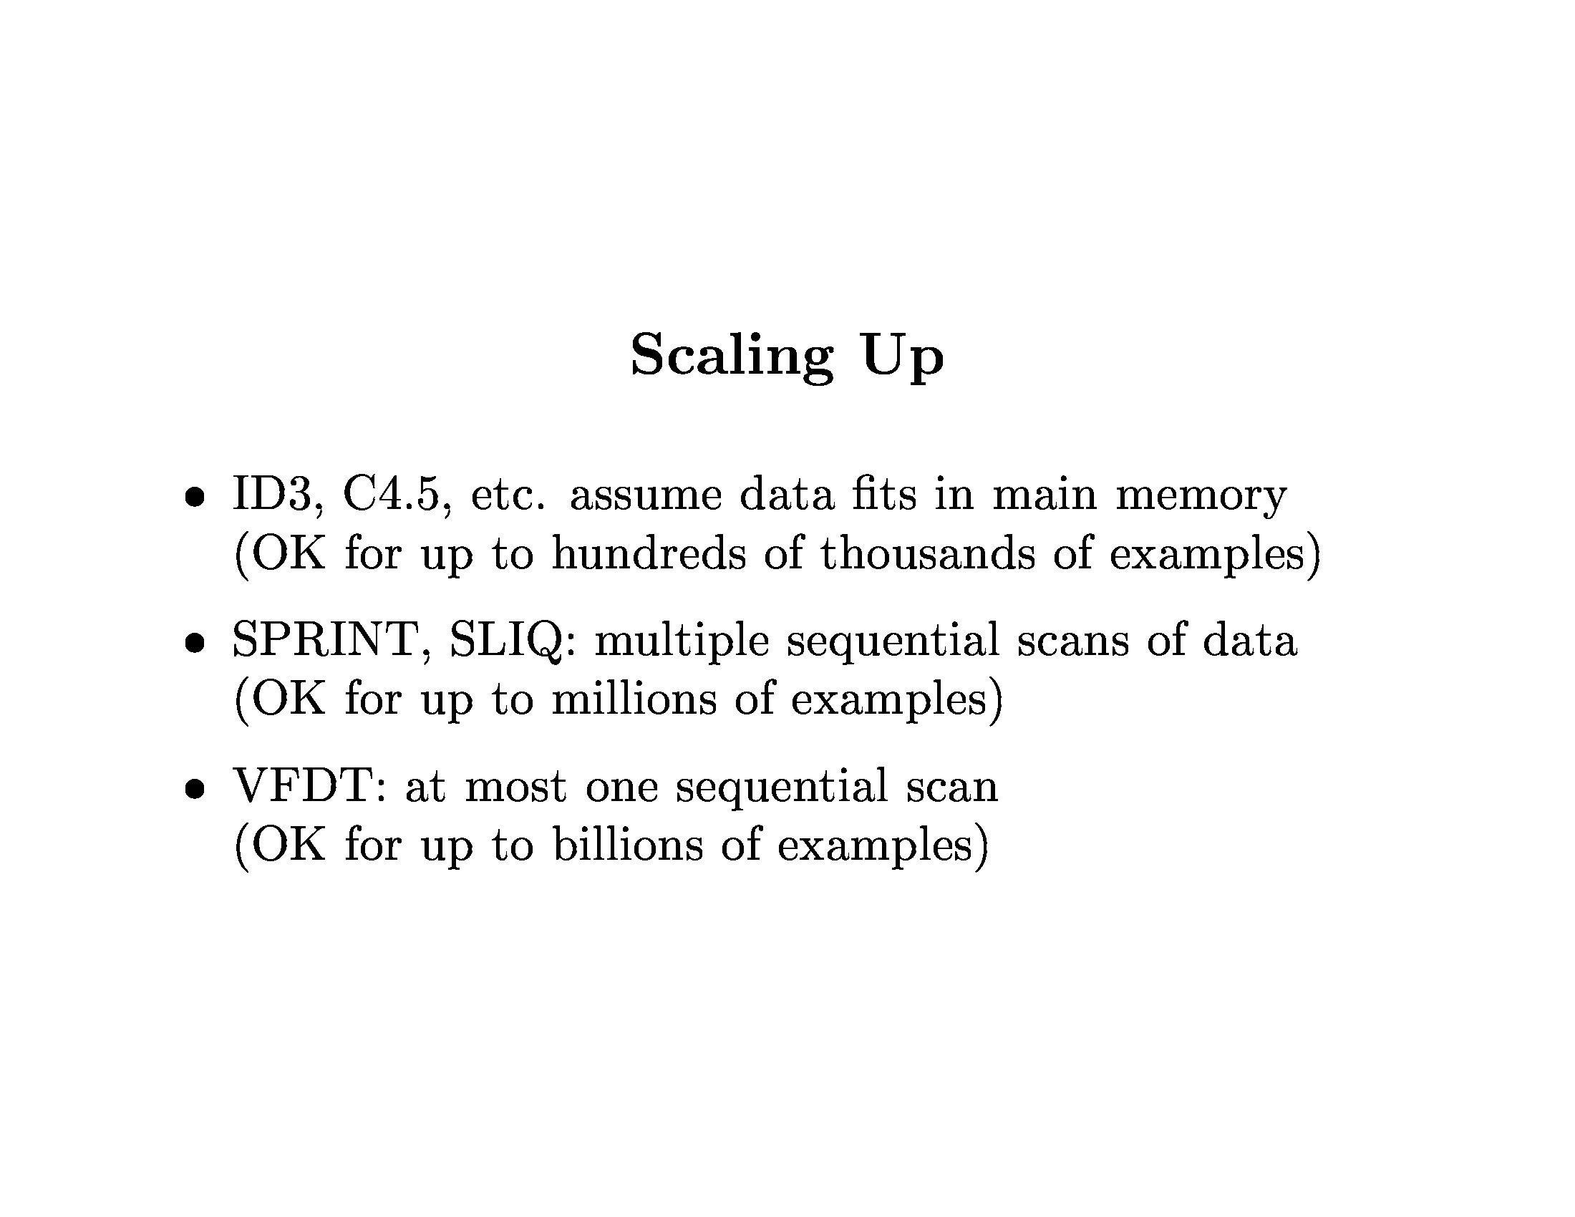

Slide 37
Decision Trees: Summary
Representation=decision trees
Bias=preference for small decision trees
Search algorithm=
Heuristic function=information gain or
information content or others
Overfitting and pruning
Advantage is simplicity and easy conversion to rules.

